Slide 1
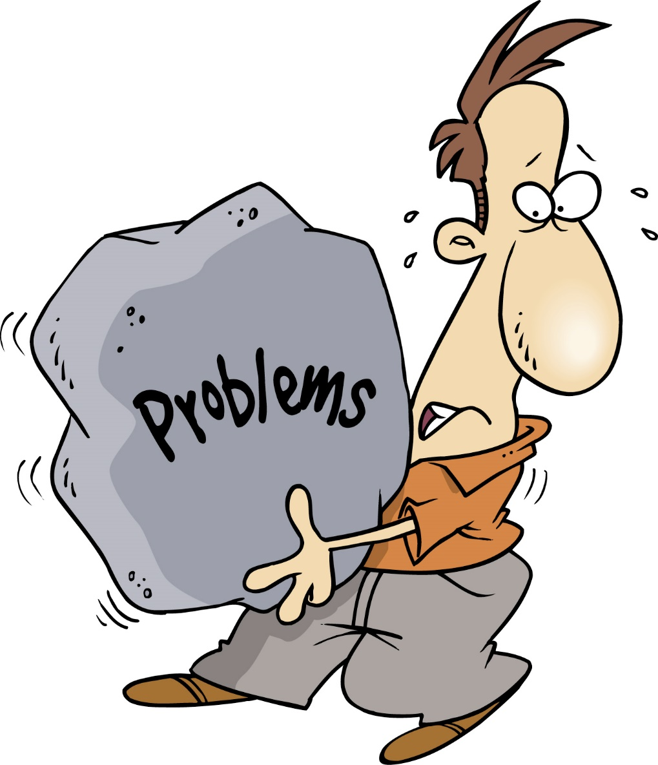
Critical Thinking
John is a human All humans have brains Therefore, John has a brain
John is a fast runner John is a University of Greenwich student Therefore, all University of Greenwich students are fast runners

Slide 2

Critical Thinking

Slide 3

Critical Thinking
Critical thinking is the ability to think clearly and rationally about what to do or what to believe.
It includes the ability to engage in reflective and independent thinking.
Someone with critical thinking skills is able to do the following : understand the logical connections between ideas.

Slide 4

Critical Thinking
Consider: are the materials used appropriate?
Evaluate how far the evidence, or examples used, really proves the point that the speaker claims.
Weigh up opinions, arguments or solutions against appropriate criteria.
Think through a line of reasoning through to its logical conclusion.
Check for hidden bias or hidden assumptions.
Ask yourself: does whether the evidence and argument really support the conclusions?

Slide 5
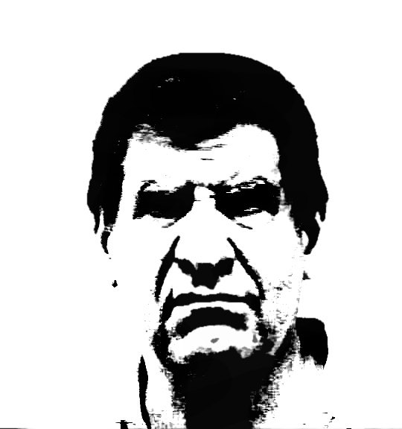

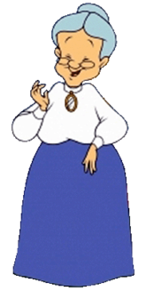
Who would you be most afraid of?

Slide 6
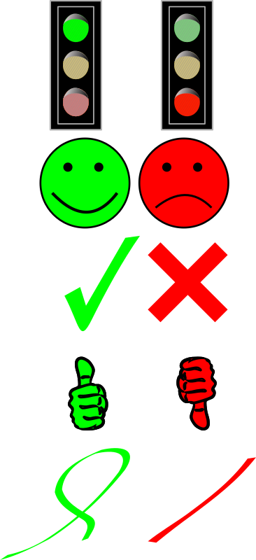
Fact or opinion?
Climate change is caused by human beings.
Leaving the European Union would cost the UK 3 million jobs.
Germany has the best national football team.
The case for cuts (austerity) is a lie.
The earth revolves around the sun.
Smoking is bad for your health.
The deepest part of the ocean is 35,813 feet (10,916 m) deep.
Bungee jumping is fun.
My mother is the best mother on earth.
South America was once joined to Africa

